Slide 1
The four modes of communication and the four language skills
CEFR Companion Volume implementation toolbox
Boîte à outils pour la mise en œuvre volume complémentaire du CECR
© 2023. This work is licensed under an Attribution-NonCommercial-ShareAlike International Creative Commons CC-BY-NC-SA 4.0 License. Attribution: Original activity from Fischer Johann (et al.) (2023), CEFR Companion Volume implementation toolbox, Council of Europe (European Centre for Modern Languages), Graz, available at www.ecml.at/companionvolumetoolbox.

Slide 2
The four modes of communication
Council of Europe (2001: 14):
“The language learner/user’s communicative language competence is activated in the performance of the various language activities, involving reception, production, interaction or mediation (in particular interpreting or translating).”

Slide 3
The four modes of communication
Council of Europe (2020: 33):
“With its communicative language activities and strategies, the CEFR replaces the traditional model of the four skills (listening, speaking, reading, writing), which has increasingly proved inadequate in capturing the complex reality of communication. […] Activities are presented under four modes of communication: reception, production, interaction and mediation.”
Descriptor scales and descriptors are now grouped according to the four modes of communication, focusing on the function of the activity.

Slide 4
The four modes of communication
Council of Europe (2020: 33):
“With its communicative language activities and strategies, the CEFR replaces the traditional model of the four skills (listening, speaking, reading, writing) […]”
Irritation among teachers:
What shall we teach?
How can we teach the four modes?
What shall an examination look like?
→ The four skills are still relevant in teaching, learning and assessment.

Slide 5
The four modes of communication and the four skills
The relationship between
the four modes of communication and
the four language skills?

Slide 6
The four modes of communication and the four skills
What is the relationship between the four modes of communication and the four language skills?
The four language skills (listening, reading, speaking and writing) are still necessary skills for teaching, learning and assessment, while the four modes of communication focus on the purpose or the macro-functions (“interpersonal”, “transactional” and “evaluative”) of communication. (see Council of Europe 2020: 33)

Slide 7
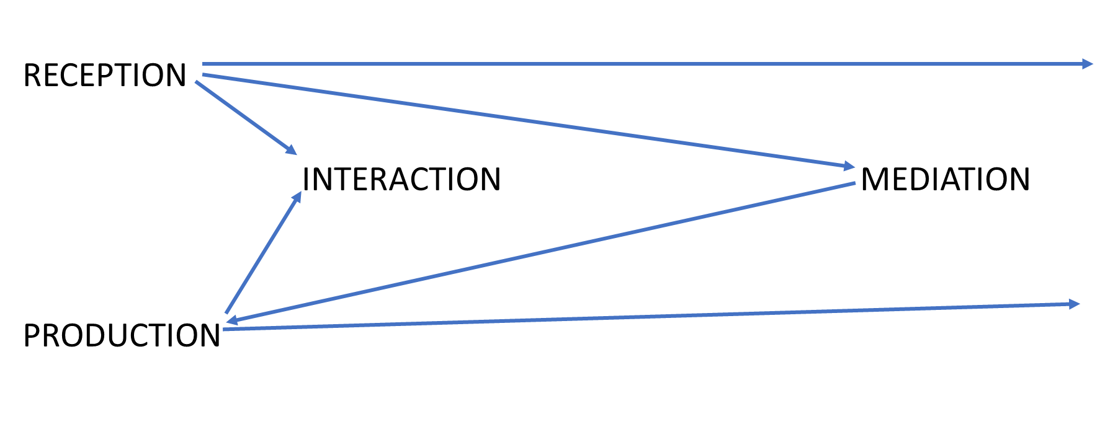
The four modes of communication
Council of Europe (2020): Common European Framework for Languages: Learning, Teaching, Assessment. Companion volume, 34.
https://rm.coe.int/common-european-framework-of-reference-for-languages-learning-teaching/16809ea0d4

Slide 8
The four modes of communication and the four skills
Reception and production
addressing the four skills individually / in an isolated format
learner as listener, reader, speaker or writer

Slide 9
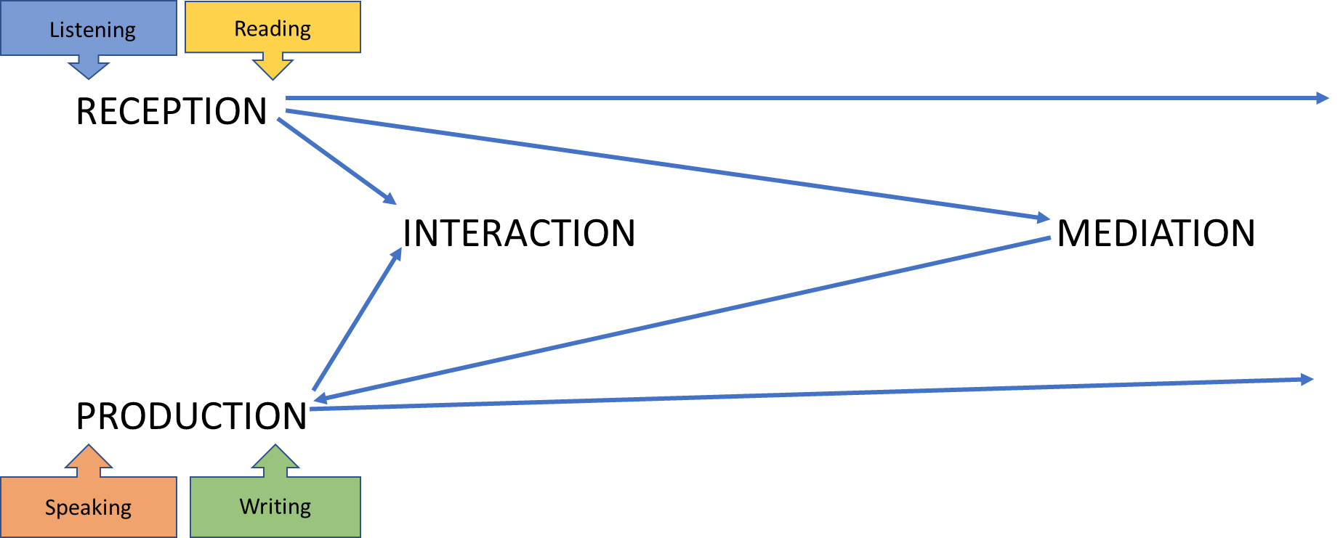
The four modes of communication and the four skills

Slide 10
The four modes of communication and the four skills
Interaction:
receptive and productive phase linked
learners as interlocutors – act as participants
negotiation of meaning

Slide 11
The four modes of communication and the four skills
Interaction:
interlocutors listen to a statement (listening) and react to it orally (speaking) – e.g. job interview
react to oral input (listening) in a written format (writing) – e.g. asking a question in the chat during a webinar or replying by email after the presentation
reading a text and reacting to it in writing – e.g. email correspondence
reading a text and reacting in speaking – e.g. giving somebody a phone call after having received their email

Slide 12
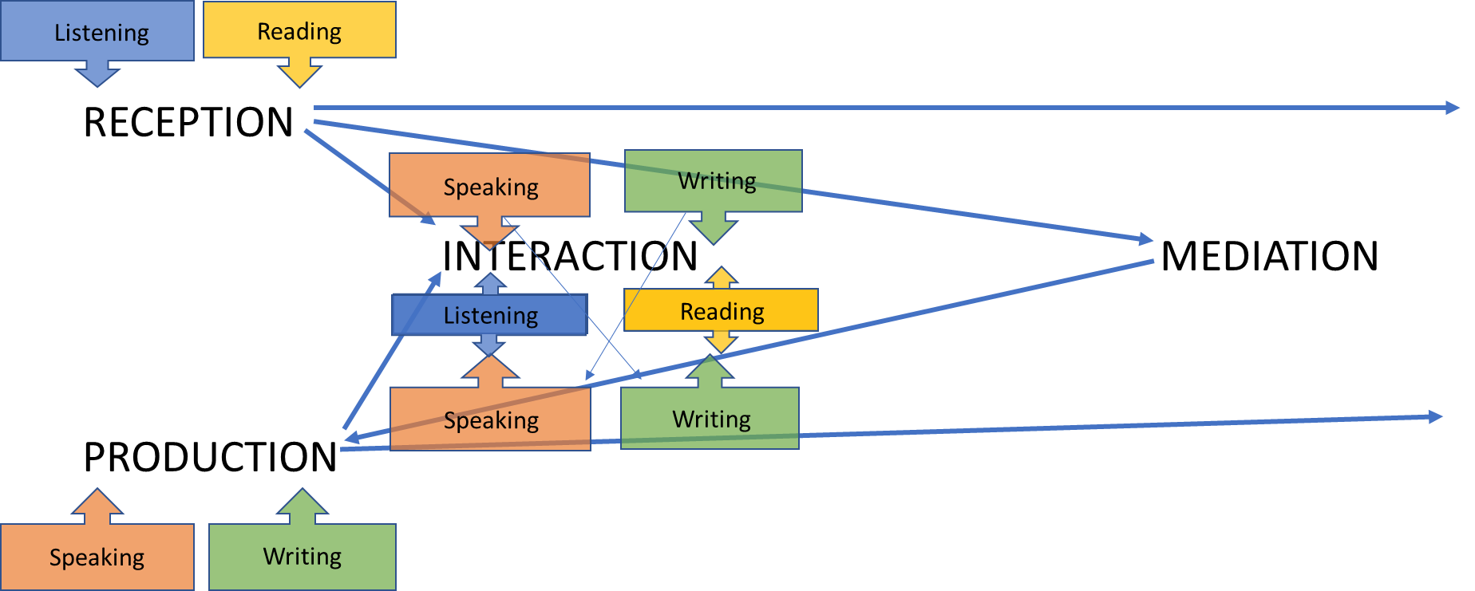
The four modes of communication and the four skills

Slide 13
The four modes of communication and the four skills
Mediation:
different written and oral sources
negotiation of meaning
co-construction of meaning
collaboration
learner as a social agent

Slide 14
The four modes of communication and the role of the learner
See: Fasoglio / Leunissen (forthcoming)

Slide 15
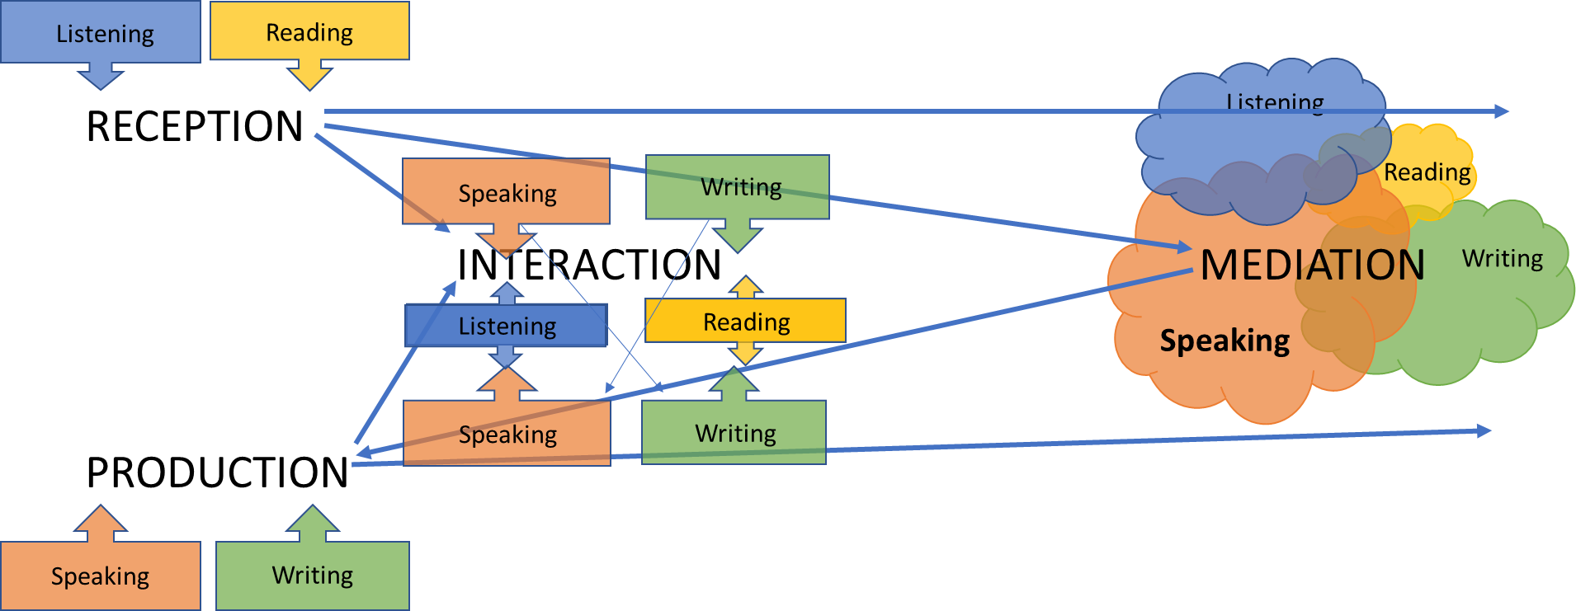
The four modes of communication and the four skills
see: Fischer / Wolder (2021: 13)

Slide 16
Mediation – a step beyond interaction
“Mediation was introduced as the fourth mode of communicative language activity in the CEFR from the earliest versions in 1996. Simply stated, whereas production is concerned with self-expression, and interaction involves the joint construction of discourse to reach mutual understanding, mediation introduces an additional element: the construction of new meaning, in the sense of new understanding, new knowledge, new concepts. Mediation usually involves reception and production – and often interaction. However, in mediation, in contrast to production and interaction, language is not just a means of expression; it is primarily a vehicle to access the ‘other,’ the new, the unknown – or to help other people to do so.”
(Piccardo, North and Goodier 2019: 20-21.)

Slide 17
The four modes of communication and the four skills
Mediation:
→ challenging tasks
integration of all four language
higher level of agency

Slide 18
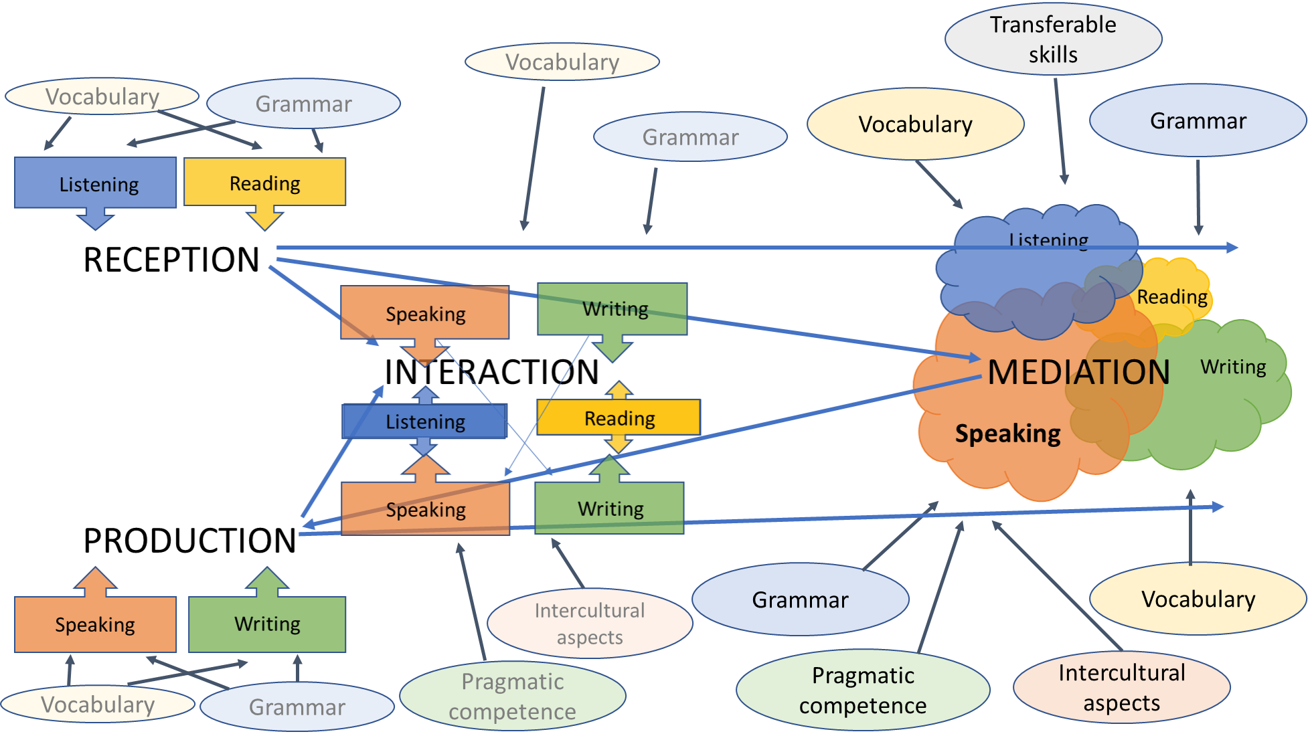
The four modes of communication and the four skills
Adapted from: Fischer / Wolder (2021: 14)

Slide 19
The four modes of communication and the four skills
Relevance of other skills particularly in interaction and mediation
paralinguistic skills
pragmatic competence
intercultural skills
transferable skills (see: Ehlers 2020)
content

Slide 20
The four modes of communication and the four skills
Language teaching, learning and assessment in vocational and university training:
preparation for needs and challenges of future academic and professional career
use of real-life situations and scenarios
focus on interaction and mediation (both intralinguistic and interlinguistic / cross-linguistic mediation)
→ meaningful tasks for teaching, learning and assessment

Slide 21
The four modes of communication and the four skills – Bibliography
Council of Europe (2020): Common European Framework of Reference for Languages: Learning, Teaching, Assessment. Companion Volume. Strasbourg: Council of Europe.
Ehlers, Ulf-Daniel (2020): Future Skills. Lernen der Zukunft – Hochschule der Zukunft. Wiesbaden: Springer VS.
Fasoglio, D. & Leunissen, S. (forthcoming). Taalprofielen 2023. Enschede: SLO.
Fischer, Johann / Wolder, Nicole (2021): Erfahrungen in der Umsetzung der Inhalte des Begleitbands zum GeR im Hochschulkontext – Ergebnisse eines Projektes des Europarates und Handlungsbedarf für Hochschulsprachenzentren. Fremdsprachen und Hochschule 96, 7-27.
Piccardo, E., North, B. & Goodier, T. (2019): Broadening the Scope of Language Education: Mediation, Plurilingualism, and Collaborative Learning: the CEFR Companion Volume. Journal of e-Learning and Knowledge Society 15(1). Italian e-Learning Association. https://www.learntechlib.org/p/207532/.
ECML resources:
METLA – Mediation in teaching, learning and assessment: www.ecml.at/mediation

